Slide 1

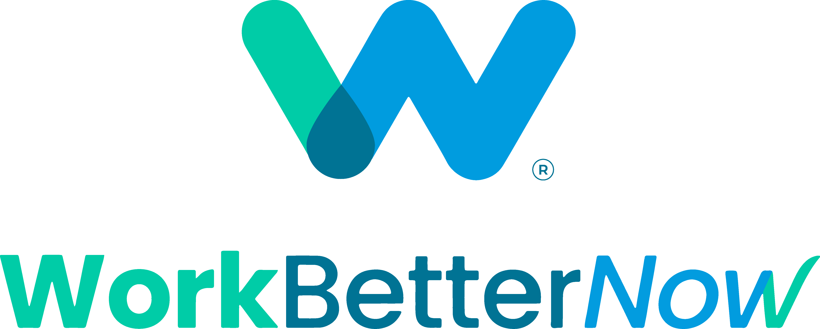
  ​Rethinking Talent:
The updated playbook for today’s workforce

Slide 2
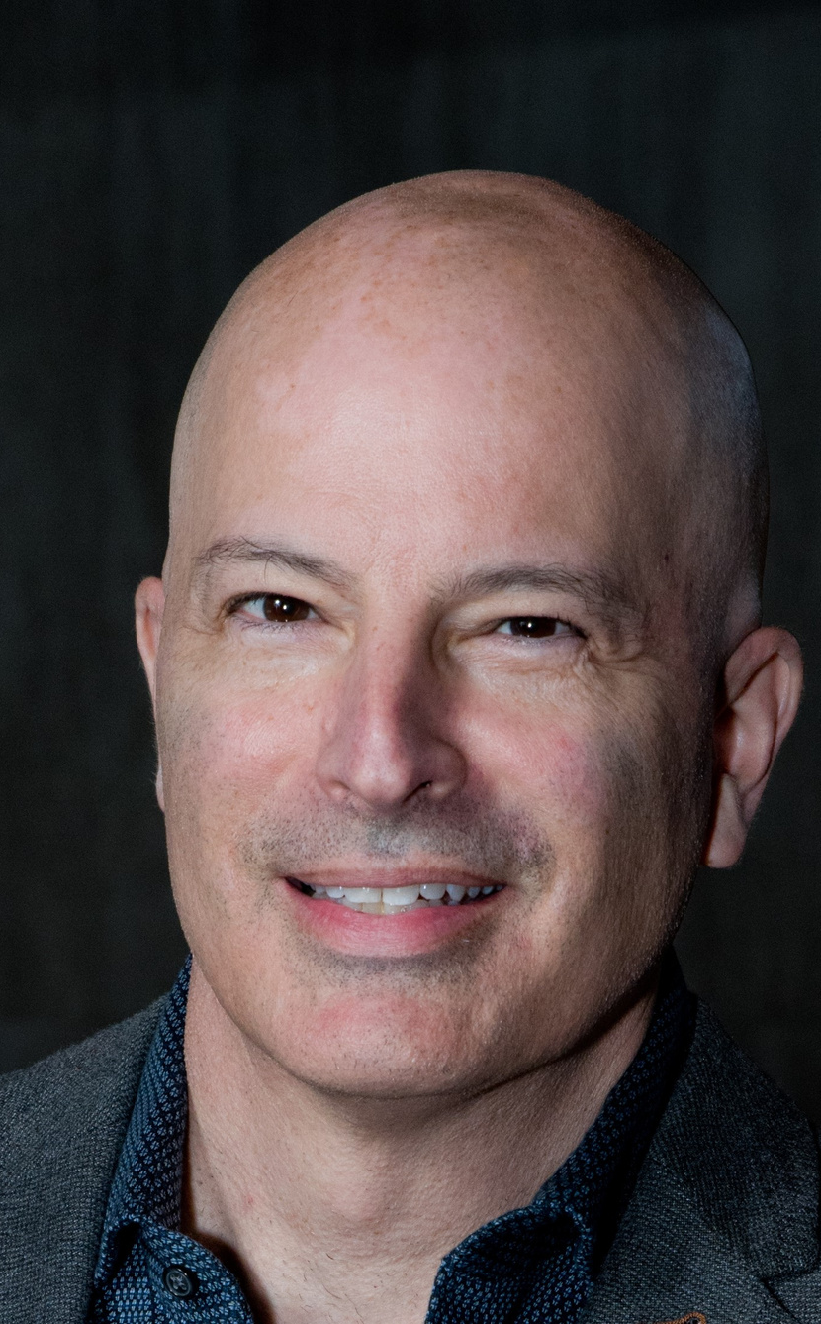
About Rob Levin
  WorkBetterNow's Co-Founder & Chairman
  Founder and Publisher of The New York Enterprise Report
  Serial entrepreneur who has run several fast-growing businesses​
  MBA & Big 6 CPA
© 2024 WORKBETTERNOW. All Rights Reserved. ​
2

Slide 3
Small and midsize business are in a
talent crisis
© 2024 WORKBETTERNOW. All Rights Reserved. ​
3

Slide 4
Labor shortage
9.5 M
6.5 M
Job openings in the US
Unemployed workers in the US
Source: US Chamber of Commerce
© 2024 WORKBETTERNOW. All Rights Reserved. ​
4
“Deciding what not to do is as important as deciding what to do.” - Steve Jobs

Slide 5
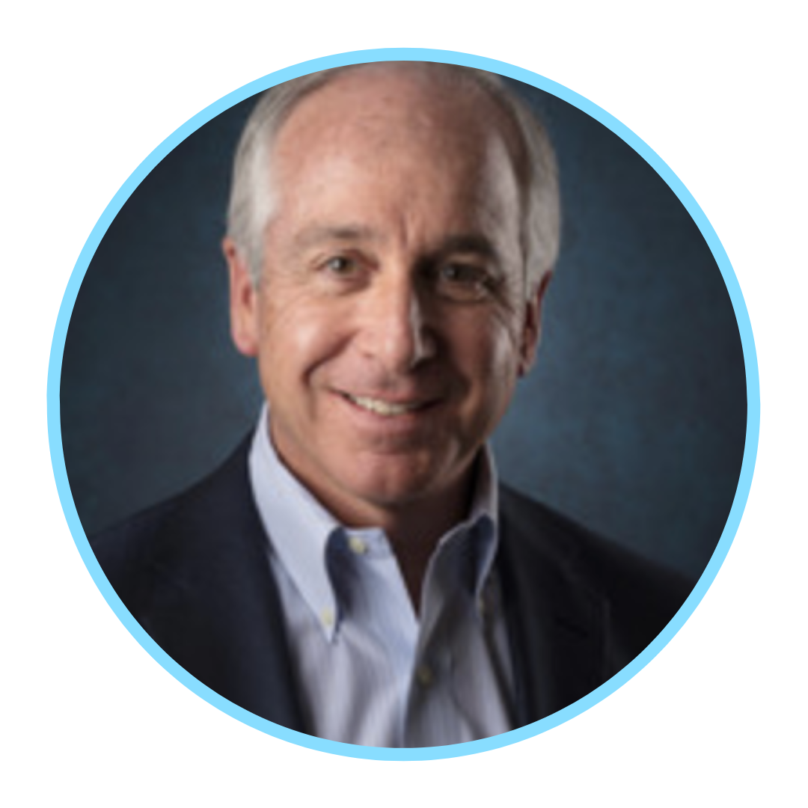
Increasing salary expectations
"As long as job openings outnumber job seekers, workers will have more leverage to negotiate for what they want. When weighing career options, workers often consider salary first and foremost.”
55%
Despite overall salary growth in the United States, more than half of professionals feel underpaid.
Paul McDonald
Senior Executive Director at Robert Half
4 ​
Source: PR Newswire. (27 Sep, 2022) U.S. Workers Share Salary Expectations and Priorities in Today's Job Market.
© 2024 WORKBETTERNOW. All Rights Reserved. ​
5

Slide 6
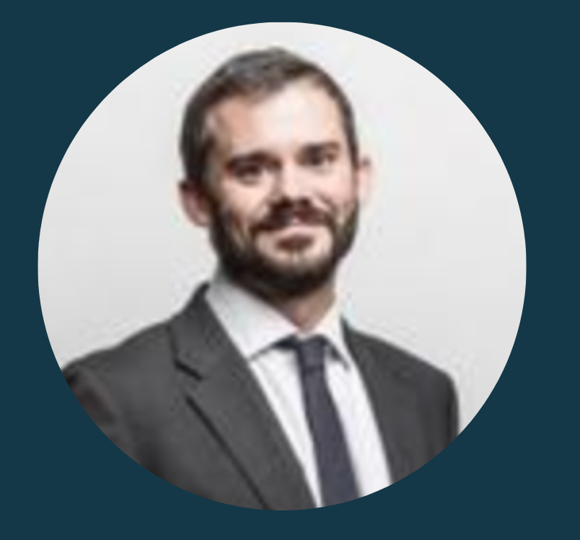
Long hiring time
"As our data shows, time to hire has risen consistently for the last four years. Make no mistake, the hiring market is not going to get easier any time soon. HR and Talent leaders will need to continue to innovate and transform their strategies for acquiring, developing and retaining talent."
44
days
Is the average time-to-hire rate in 2023
Jim Sykes
Global Managing Director of Client Operations at AMS
Source: The 2023 Global Talent Climate report from The Josh Bersin Company, as read in PR Newswire
© 2024 WORKBETTERNOW. All Rights Reserved. ​
6

Slide 7
Diminished productivity
2.7%
68%
Decrease in labor productivity, its lowest since 2005
Of the US workforce is not engaged at work.
According to a report by Forbes, labor productivity in the United States decreased by 2.7% in the first quarter of 2023 for the nonfarm business sector, which was the sharpest decline in 75 years.
When broken down, a disengaged employee costs a company, on average, 34% of their annual salary every year. That means a company loses $3,400 for every $10,000 a disengaged employee earns.
Source: Forbes & Zippia
© 2024 WORKBETTERNOW. All Rights Reserved. ​
7

Slide 8
A generational phenomenon
18M
31%
TikTok views
Of hiring managers prefer not to hire Gen Z
Made the "lazy girl job" a trending topic. The anti-work, anti-ambition sentiment has been growing among Gen Z for quite some time now (reminiscent of quiet quitting). This emerging attitude is well-supported by statistics.
Preferring older workers instead, citing reasons such as high salary demands (42%), entitlement (41%), and lack of communication skills (39%)
30% of people between 25 to 34 said they're doing the bare minimum at work.
Source: How many hiring managers are approaching their Gen Z problem — and why it's a big risk- The Business Journals
© 2024 WORKBETTERNOW. All Rights Reserved. ​
8

Slide 9
An "uphill battle" for small and medium-sized businesses
56%
35%
70%
of small businesses face their greatest challenge in finding great talent
find it harder to recruit employees now compared to five years ago
of small business spending is attributed to labor
Source: Small Business Statistics 2023 https://www.forbes.com/advisor/business/small-business-statistics/
© 2024 WORKBETTERNOW. All Rights Reserved. ​
9

Slide 10






The Aftermath
Diminished productivity
Frustrated and overworked staff
Unrealized growth
Poor customer experience
Increased costs
To name a few...
© 2024 WORKBETTERNOW. All Rights Reserved. ​
10

Slide 11


Change & Business
The pace of change in Business keeps increasing. Lately at a faster rate.
Harness and leverage this change, businesses need new capabilities
Businesses who do not acquire new capabilities fall victim to change
“It’s easy to come up with new ideas; the hard part is letting go of what worked for you two years ago but will soon be out of date.” —Roger von Oech.
© 2024 WORK BETTER NOW. All Rights Reserved.​
11

Slide 12

Now what?
Focus on retention, attracting and reskilling
AI and automation
Alternative sources for talent
© 2024 WORKBETTERNOW. All Rights Reserved. ​
12

Slide 13





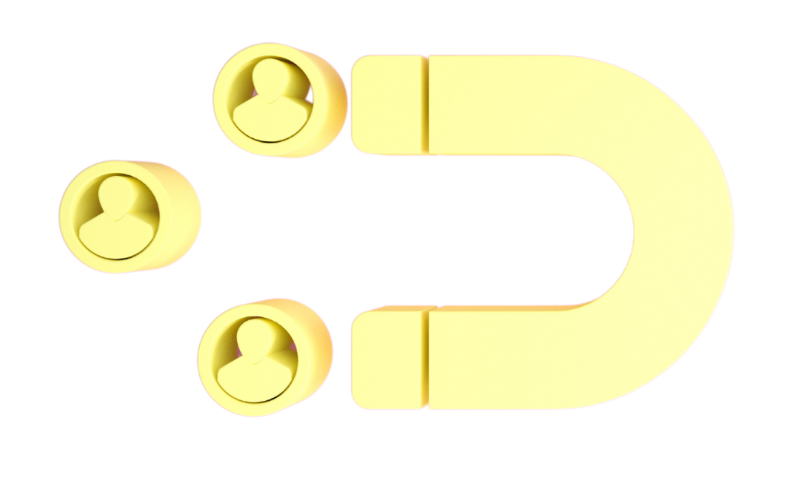


Focus on Retention
Competitive compensation
Career advancement opportunities
Upskilling and reskilling
Foster an appealing company culture
Promote work-life balance
Recognition and rewards
Remove bad apples and poor performers
© 2024 WORKBETTERNOW. All Rights Reserved. ​
13

Slide 14


Attracting Better Talent
Identify the “must-have attributes" and upskill
Double down on employer branding
Make sure your recruiting and onboarding process is effective and efficient
Consider implementing remote work policies
© 2024 WORKBETTERNOW. All Rights Reserved. ​
14

Slide 15
Internal mobility and upskilling
Median employee tenure for companies in the top and bottom quartiles of internal mobility
Employees at companies with high internal mobility stay 60% longer
4.9
Years
3.1
Years
Source: Global LinkedIn data, as of Jan 2023.
Companies with
low internal mobility
Companies with
High internal mobility
© 2024 WORKBETTERNOW. All Rights Reserved. ​
15

Slide 16

Embrace AI and automation
Automating repetitive tasks
It’s not AI that is going to take your job, but someone who knows how to use AI might.
Content generation
Policies and procedures
Richard Baldwin
Economist and professor at the Geneva Graduate Institute
Data analysis with AI
Unsure on how to tap into AI and Automation? Rely on your digital-native workforce - They're the ones who'll lead the charge.
© 2024 WORKBETTERNOW. All Rights Reserved. ​
16

Slide 17

New Sources for Talent
© 2024 WORKBETTERNOW. All Rights Reserved. ​
17

Slide 18
Is remote work the solution for your business?
© 2024 WORKBETTERNOW. All Rights Reserved. ​
18

Slide 19

Why Remote
Wider talent pool
Potentially lower salaries
Lower overhead
Attract better talent
© 2024 WORKBETTERNOW. All Rights Reserved. ​
19

Slide 20
Best practices to manage remote talent,
But first...
Acknowledge that a remote work culture will reflect the in-office culture to a significant extent.
Recognize that many effective strategies for managing remote talent are akin to those employed for in-office teams.
“A team is not a group of people who work together. A team is a group of people who trust each other.” – Simon Sinek
© 2024 WORK BETTER NOW. All Rights Reserved.​
20

Slide 21

Best practices to manage remote talent-
And Now...
Clarity
Ensure clear understanding about:
Working hours
Responsibilities
Communication standards
Define success
© 2024 WORKBETTERNOW. All Rights Reserved. ​
21

Slide 22

Best practices to manage remote talent-
Tools
Access to data
Implement collaborative and cloud-based software:
Utilize platforms like Google Suite, Office 365/OneDrive
Security
© 2024 WORKBETTERNOW. All Rights Reserved. ​
22

Slide 23

Best practices to manage remote talent-
Communication
Establish consistent communication:
Regular 1-on-1 calls
Departmental meetings
Company-wide calls
Emphasize video (over voice) communication
Remember there is no water cooler
Highlight successes of remote team members
Foster informal connections
© 2024 WORKBETTERNOW. All Rights Reserved. ​
23

Slide 24
Is overseas talent the next step for your business?
© 2024 WORKBETTERNOW. All Rights Reserved. ​
24

Slide 25

Why Overseas
[It’s not just about the money]
Ample talent pool
  Experience/talent
  English
  Attitude
Hire faster
Less legal and regulatory issues
Lower overhead
Lower cost of living > lower salaries
© 2024 WORKBETTERNOW. All Rights Reserved. ​
25

Slide 26









What Can Overseas Professionals Do?
Marketing Management
Accounting and Admin
Customer Service
Quality Control Management
Software Development
Bookkeeping
IT Support
Data Entry
Project Management
© 2024 WORK BETTER NOW. All Rights Reserved.​
26

Slide 27



Where to source from?
Considerations
Time zone alignment
Importance of
English proficiency
Cultural similarities
© 2024 WORKBETTERNOW. All Rights Reserved. ​
27

Slide 28
Using a Talent Provider
Considerations
How does the talent provider evaluate worker skills?
How do they gauge personality and attitude alignment?
How many screening interviews are conducted before presenting candidates?
What's their approach to evaluating English proficiency?
How do they match candidates with prospective clients?
© 2024 WORK BETTER NOW. All Rights Reserved.​
28

Slide 29

What Have EOS® Businesses Been Able to Achieve with Overseas Talent?
© 2024 WORKBETTERNOW. All Rights Reserved. ​
29

Slide 30
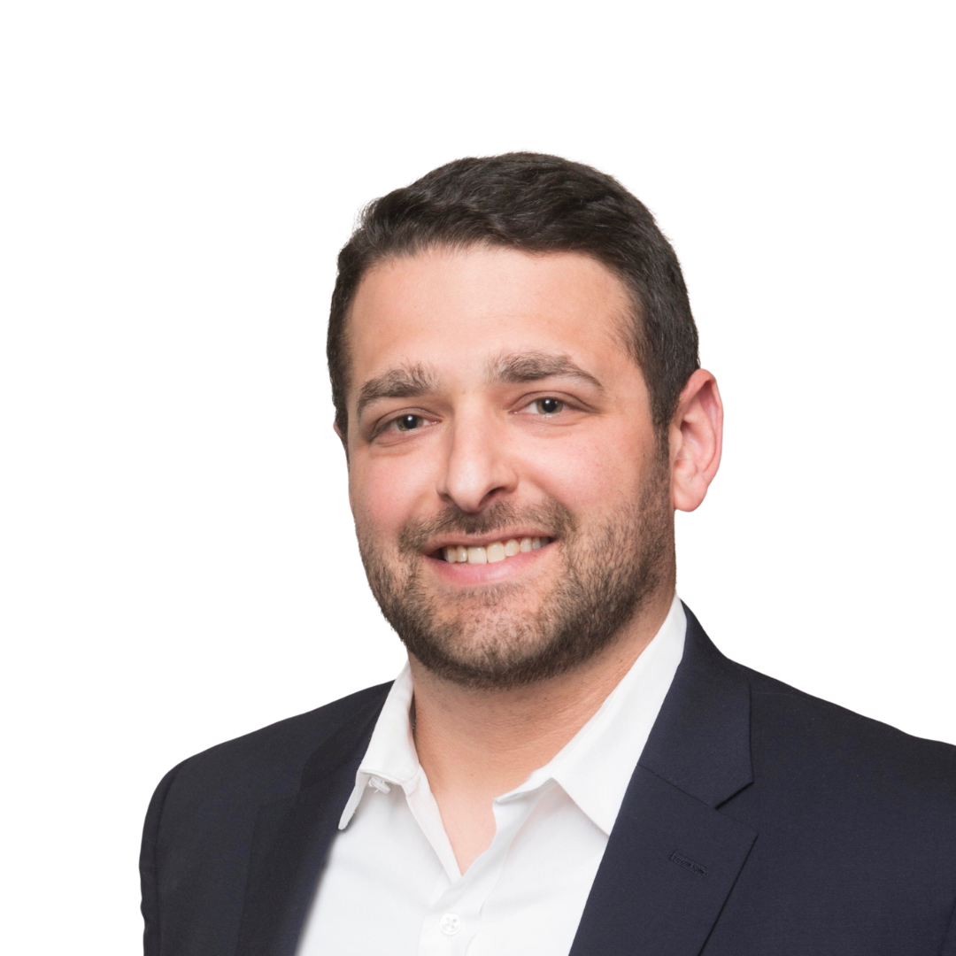
“Not only did my WBN professionals learn the EOS system quickly, but they've helped me step out of the day-to-day tasks so I can focus on strategy. They're really the backbone of my business.”
Andrew Schenkel
CEO at Double Play Marketing
Running on EOS®
© 2024 WORK BETTER NOW. All Rights Reserved.​
30
Notes:
By the way, Eliot and Noleen worked with Bridget as their assistant accelator, here is Eliot's testimonial "Working with Bridget was one of the best investments I made in scaling my practice. Bridget efficiently helped me clarify the role of my first virtual assistant. From there, she onboarded my assistant quickly and effectively. Together, they put in place the “best practice” processes, tools, and disciplines I needed to systemize my EOS® practice. Within 30 days, I was able to delegate and elevate with the systems in place. Within 60 days, my assistant was managing my practice and me!"
Eliot Wajskol, Certified EOS® Implementer

Slide 31

“EOS helps us define clear roles and responsibilities, and WBN has become our talent partner providing the Right People and allowing us to scale sustainably”
Dimitri Mortsakis
CEO at CRS
Running on EOS®
© 2024 WORK BETTER NOW. All Rights Reserved.​
31
Notes:
By the way, Eliot and Noleen worked with Bridget as their assistant accelator, here is Eliot's testimonial "Working with Bridget was one of the best investments I made in scaling my practice. Bridget efficiently helped me clarify the role of my first virtual assistant. From there, she onboarded my assistant quickly and effectively. Together, they put in place the “best practice” processes, tools, and disciplines I needed to systemize my EOS® practice. Within 30 days, I was able to delegate and elevate with the systems in place. Within 60 days, my assistant was managing my practice and me!"
Eliot Wajskol, Certified EOS® Implementer

Slide 32
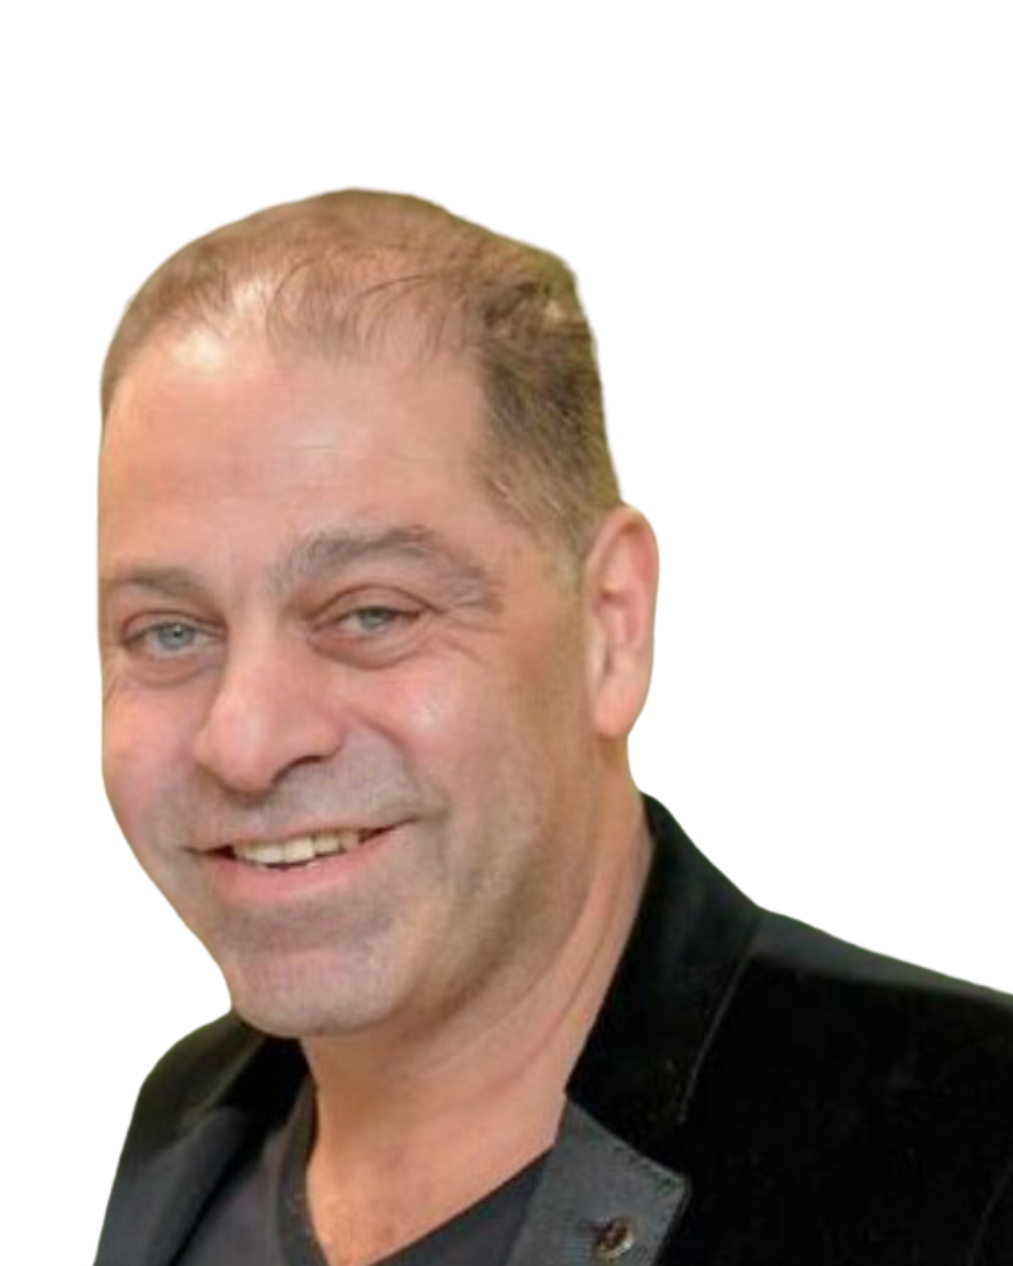
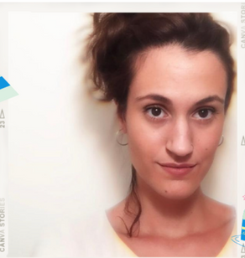
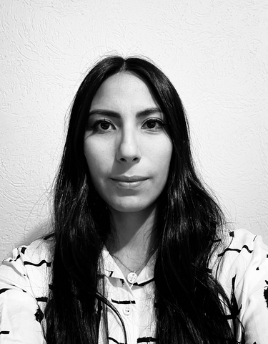
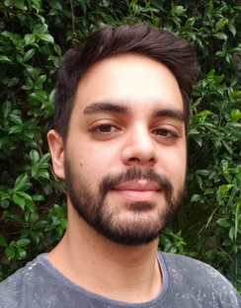
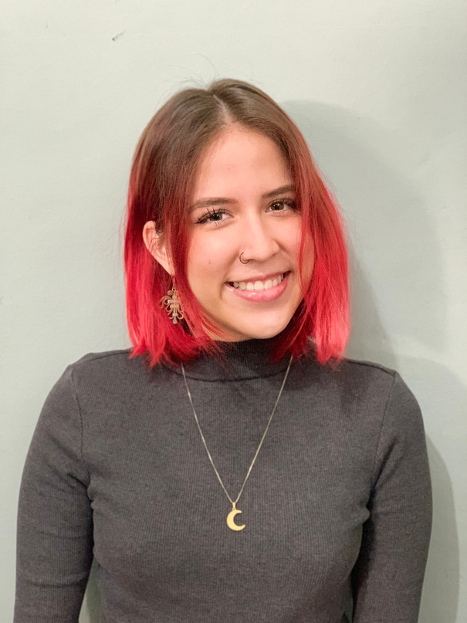
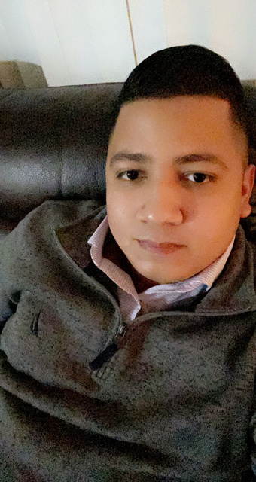
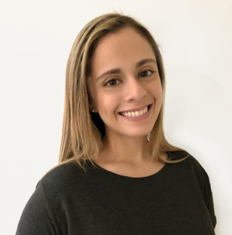
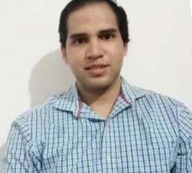
“WorkBetterNow and their team of talent is transforming my business every day. I only wish I knew about WBN and its amazing people 20 years ago.”
Larry Zogby
President at RDS Delivery
Sofia D. -Customer Services & Sales Representative
Ana B. -
Administrative assistant
Nicolas B. -
Dispatch Support
Carmen P. -
Customer Support
Roberto Q. -
Dispatch Support
Gabriela P. -
Community Manager
Javier R. -
Fleet Safety Manager
Notes:
By the way, Eliot and Noleen worked with Bridget as their assistant accelator, here is Eliot's testimonial "Working with Bridget was one of the best investments I made in scaling my practice. Bridget efficiently helped me clarify the role of my first virtual assistant. From there, she onboarded my assistant quickly and effectively. Together, they put in place the “best practice” processes, tools, and disciplines I needed to systemize my EOS® practice. Within 30 days, I was able to delegate and elevate with the systems in place. Within 60 days, my assistant was managing my practice and me!"
Eliot Wajskol, Certified EOS® Implementer

Slide 33


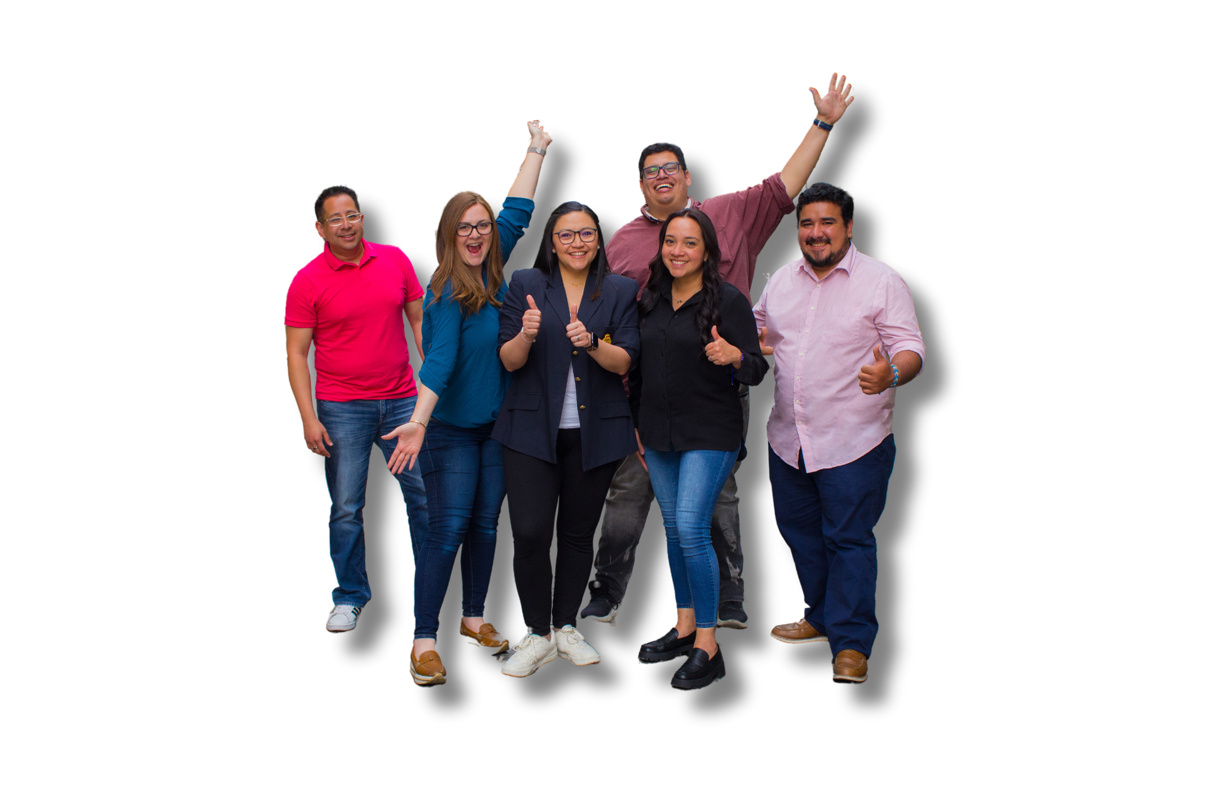

WorkBetterNow runs on EOS®, and 83% of the WBN team is based in LATAM
© 2024 WORK BETTER NOW. All Rights Reserved.​
33

Slide 34
Start with an executive assistant (EA) to help you focus on your Unique Ability™
Where to begin with nearshore talent?
© 2024 WORKBETTERNOW. All Rights Reserved. ​

Slide 35
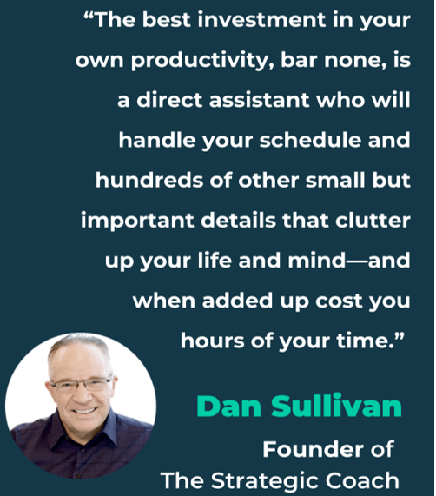
Strategic Coach principles on Delegate and Elevate
Unique Ability®
Who Not How ™
  "If you don't have an assistant,
  You are one"

Slide 36

“With my WBN assistant, Noleen, handling day-to-day activities and streamlining
processes, I've gained
40 hours per month back into
my schedule.”
Eliot Wajskol
Certified EOS Implementer®
© 2024 WORK BETTER NOW. All Rights Reserved.​
36
Notes:
By the way, Eliot and Noleen worked with Bridget as their assistant accelator, here is Eliot's testimonial "Working with Bridget was one of the best investments I made in scaling my practice. Bridget efficiently helped me clarify the role of my first virtual assistant. From there, she onboarded my assistant quickly and effectively. Together, they put in place the “best practice” processes, tools, and disciplines I needed to systemize my EOS® practice. Within 30 days, I was able to delegate and elevate with the systems in place. Within 60 days, my assistant was managing my practice and me!"
Eliot Wajskol, Certified EOS® Implementer

Slide 37
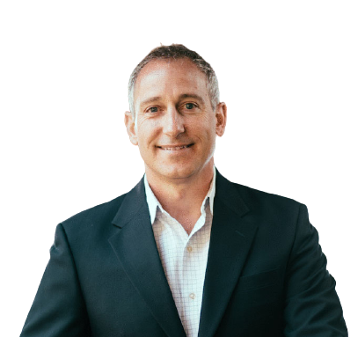
"Our WBN professionals ‘Get’ the work we hire them for and have ‘Capacity’ as full-time hires. The one thing that’s blown us away is their high level of ‘Want it’. It's incredible and something we don't see that often.”
Jim Paras
Certified EOS Implementer®
© 2024 WORK BETTER NOW. All Rights Reserved.​
37
Notes:
By the way, Eliot and Noleen worked with Bridget as their assistant accelator, here is Eliot's testimonial "Working with Bridget was one of the best investments I made in scaling my practice. Bridget efficiently helped me clarify the role of my first virtual assistant. From there, she onboarded my assistant quickly and effectively. Together, they put in place the “best practice” processes, tools, and disciplines I needed to systemize my EOS® practice. Within 30 days, I was able to delegate and elevate with the systems in place. Within 60 days, my assistant was managing my practice and me!"
Eliot Wajskol, Certified EOS® Implementer

Slide 38

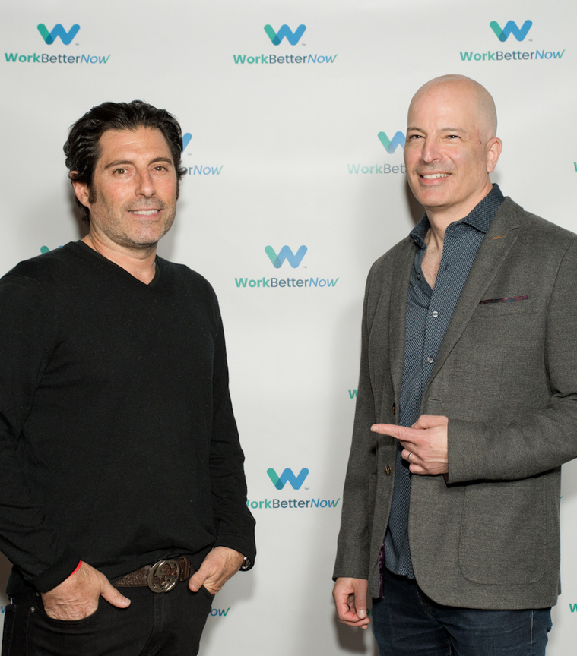
About WBN
From executive assistants to project managers, WBN provides pre-vetted, hand-matched, full-time top talent from Latin America. ​
When you work with WBN
You have a new top member of your team in 2 weeks (not the 3 months it usually takes to hire)
More than 40+ roles
You get a dedicated success coach to help you support onboarding (and beyond)
Low risk of a bad hire, no long-term contracts, cancel anytime
$2350/mo for each dedicated, full-time professional.
© 2024 WORK BETTER NOW. All Rights Reserved.​
Ready to start working better now? ​
38

Slide 39

Q&A
Special Offer
Mention “EOS CONFERENCE” for $150 off for the first three months and start Working Better Now.
WorkBetterNow.com
© 2024 WORKBETTERNOW. All Rights Reserved. ​
39

